Slide 1

C# Introduction
Basic Syntax , I/O, Conditions, Loops and Debugging
Software University
Technical Trainers
Software University
https://softuni.bg

Slide 2
Table of Contents
Introduction and Basic Syntax
Input / Output
Comparison Operators
Implementing Control-Flow Logic
Logical Operators
Loops
Debugging and Troubleshooting

Slide 3
Have a Question?
sli.do
#fund-csharp

Slide 4
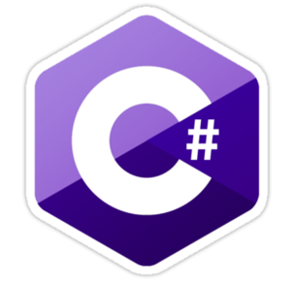
Introduction and Basic Syntax

Slide 5
C# Programming Language
C# is modern, flexible, general-purpose programming language
Object-oriented by nature, statically-typed, compiled
Runs on .NET Framework / .NET Core
static void Main() {
// Source code
}
Program starting point

Slide 6
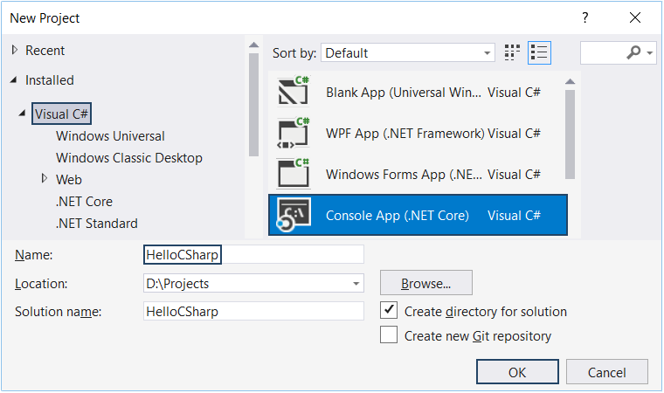
Using Visual Studio
Visual Studio (VS) is powerful IDE for C#
Create a console application

Slide 7
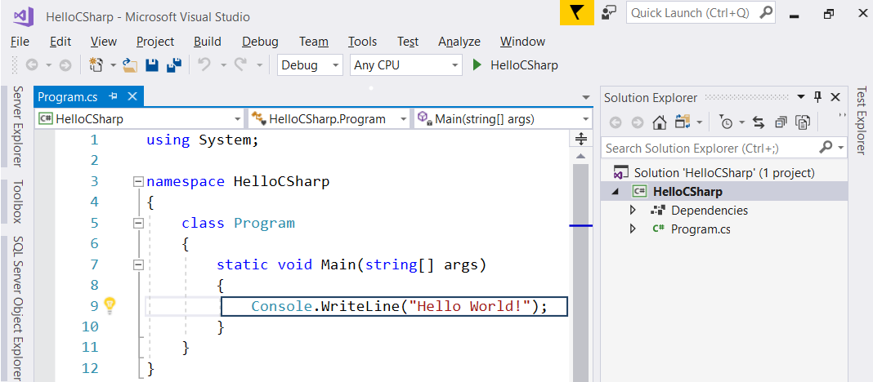
Running the Program
Start the program from VS using [Ctrl + F5]

Slide 8
Declaring Variables
Defining and Initializing variables
Example:
{data type / var} {variable name} = {value};
Variable name
int number = 5;
Data type
Variable value

Slide 9

Input / Output
Reading from and Writing to the Console

Slide 10
Reading from the Console
We can read/write to the console, using the Console class
Use the System namespace to access System.Console class
Reading input from the console using Console.ReadLine():
using System;
Returns string
string name = Console.ReadLine();

Slide 11
Converting Input from the Console
Console.ReadLine() returns a string
Convert the string to number by parsing:
string name = Console.ReadLine();
int age = int.Parse(Console.ReadLine());
double salary = double.Parse(Console.ReadLine());
bool isHungry = bool.Parse(Console.ReadLine());

Slide 12
Printing to the Console
We can print to the console using the Console class
Use the System namespace to access System.Console class
Writing output to the console:
Console.Write()
Console.WriteLine()
Console.Write("Hi, ");
Console.WriteLine("John!");
// Hi, John!

Slide 13
Using Placeholders
Using placeholders to print on the console
Examples:
Placeholder {0} corresponds to name
string name = "George";
int age = 5;
Console.WriteLine("Name: {0}, Age: {1}", name, age);
// Name: George, Age: 5
Placeholder {1} corresponds to age

Slide 14
Formatting Numbers in Placeholders
D – format number to certain digits with leading zeros
F – format floating point number with certain digits after the decimal point
Examples:
double grade = 5.5334;
int percentage = 55;
Console.WriteLine("{0:F2}", grade); // 5.53
Console.WriteLine("{0:D3}", percentage); // 055

Slide 15
Using String Interpolation
Using string interpolation to print on the console
Examples:
string name = "George";
int age = 5;
Console.WriteLine($"Name: {name}, Age: {age}");
// Name: George, Age 5
Put $ in front of the string to use string interpolation

Slide 16
Problem: Student Information
You will be given 3 input lines:
Student Name, Age and Average Grade
Print the input in the following format:
"Name: {name}, Age: {age}, Grade: {grade}"
Format the grade to 2 decimal places
John
15
5.40
Name: John, Age: 15, Grade: 5.40
Check your solution here: https://judge.softuni.org/Contests/Practice/Index/1188#0

Slide 17
Solution: Student Information
string name = Console.ReadLine();
int age = int.Parse(Console.ReadLine());
double grade = double.Parse(Console.ReadLine());
Console.WriteLine($"Name: {name}, Age: {age}, Grade: {grade:f2}");
Name: John, Age: 15, Grade: 5.40
Check your solution here: https://judge.softuni.org/Contests/Practice/Index/1188#0

Slide 18
Comparison Operators
==

Slide 19
Comparison Operators
Operator | Notation in C#
Equals | ==
Not Equals | !=
Greater Than | >
Greater Than or Equals | >=
Less Than | <
Less Than or Equals | <=

Slide 20
Comparing Numbers
Values can be compared:
int a = 5;
int b = 10;
Console.WriteLine(a < b);
Console.WriteLine(a > 0);
Console.WriteLine(a > 100);
Console.WriteLine(a < a);
Console.WriteLine(a <= 5);
Console.WriteLine(b == 2 * a);
// true
// true
// false
// false
// true
// true

Slide 21
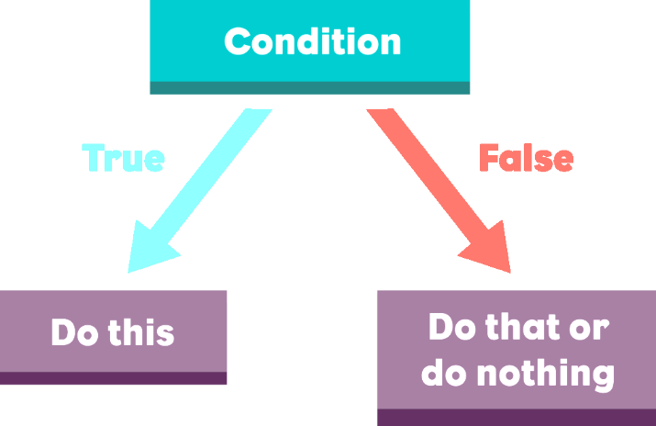
Implementing Control-Flow Logic
The If-else Statement

Slide 22
The If Statement
The most simple conditional statement
Test for a condition
Example: Take as an input a grade and check if the student has passed the exam (grade >= 3.00)
double grade = double.Parse(Console.ReadLine());
if (grade >= 3.00)
{
Console.WriteLine("Passed!");
}
In C# the opening bracket stays on a new line
Check your solution here: https://judge.softuni.org/Contests/Practice/Index/1188#2

Slide 23
The If-else Statement
Executes one branch if the condition is true and another if it is false
Example: Upgrade the last example, so it prints "Failed!" if the mark is lower than 3.00:
if (grade >= 3.00)
{
Console.WriteLine("Passed!");
}
else
{
// TODO: Print the message
}
The else keyword stays on a new line
Check your solution here: https://judge.softuni.org/Contests/Practice/Index/1188#2

Slide 24
Problem: Back in 30 Minutes
Write a program that reads hours and minutes from the console and calculates the time after 30 minutes
The hours and the minutes come on separate lines
Example:
1
46
0
01
23
59
2:16
0:31
0:29
11
08
12
49
11
32
11:38
13:19
12:02
Check your solution here: https://judge.softuni.org/Contests/Practice/Index/1188#3

Slide 25
Solution: Back in 30 Minutes
int hours = int.Parse(Console.ReadLine());
int minutes = int.Parse(Console.ReadLine()) + 30;
if (minutes > 59) {
hours += 1;
minutes -= 60;
}
if (hours > 23) {
hours = 0;
}
Console.WriteLine("{0}:{1:D2}", hours, minutes);
Check your solution here: https://judge.softuni.org/Contests/Practice/Index/1188#3

Slide 26
The Switch-Case Statement
Simplified If-else-if-else

Slide 27
The Switch-case Statement
Switch-case statement works as a sequence of if-else
Example: Read an input number and print its corresponding month:
int month = int.Parse(Console.ReadLine());
switch (month)
{
case 1: Console.WriteLine("January"); break;
case 2: Console.WriteLine("February"); break;
// TODO: Add the other cases
default: Console.WriteLine("Error!"); break;
}
Check your solution here: https://judge.softuni.org/Contests/Practice/Index/1188#4

Slide 28

Problem: Foreign Languages
By given country print its typical language:
English -> England, USA
Spanish -> Spain, Argentina, Mexico
other -> unknown
England
English
Spain
Spanish
Check your solution here: https://judge.softuni.org/Contests/Practice/Index/1188#5

Slide 29
Solution: Foreign Languages
switch (country)
{
case "USA":
case "England": Console.WriteLine("English"); break;
case "Spain":
case "Argentina":
case "Mexico": Console.WriteLine("Spanish"); break;
default: Console.WriteLine("unknown"); break;
}
Check your solution here: https://judge.softuni.org/Contests/Practice/Index/1188#5

Slide 30
Logical Operators
&&
Writing More Complex Conditions

Slide 31
Logical Operators
Logical operators give us the ability to write multiple conditions in one if statement
They return a boolean value and compare boolean values
Operator | Notation in C# | Example
Logical NOT | ! | !false -> true
Logical AND | && | true && false -> false
Logical OR | || | true || false -> true

Slide 32
Problem: Theatre Promotions
A theatre has the following ticket prices according to the age of the visitor and the type of day
If the age is < 0 or > 122, print "Error!":
Day / Age | 0 <= age <= 18 | 18 < age <= 64 | 64 < age <= 122
Weekday | 12$ | 18$ | 12$
Weekend | 15$ | 20$ | 15$
Holiday | 5$ | 12$ | 10$
Weekday
42
Holiday
-12
18$
Error!
Check your solution here: https://judge.softuni.org/Contests/Practice/Index/1188#6

Slide 33
Solution: Theatre Promotions
var day = Console.ReadLine().ToLower();
var age = int.Parse(Console.ReadLine());
var price = 0;
if (day == "weekday")
{
if ((age >= 0 && age <= 18) || (age > 64 && age <= 122))
{
price = 12;
}
// TODO: Add else statement for the other group
} // Continues on the next slide…

Slide 34
Solution: Theatre Promotions (2)
else if (day == "weekend")
{
if ((age >= 0 && age <= 18) || (age > 64 && age <= 122))
{
price = 15;
}
else if (age > 18 && age <= 64)
{
price = 20;
}
} // Continues on the next slide…

Slide 35
Solution: Theatre Promotions (3)
else if (day == "holiday")
{
if (age >= 0 && age <= 18)
price = 5;
// TODO: Add the statements for the other cases
}
if (price != 0)
Console.WriteLine(price + "$");
else
Console.WriteLine("Error!");
Check your solution here: https://judge.softuni.org/Contests/Practice/Index/1188#6

Slide 36

Loops
Code Block Repetition

Slide 37
Loop: Definition
A loop is a control statement that repeats the execution of a block of statements. The loop can:
Execute a code block a fixed number of times
for loop
Execute a code block while a given condition returns true
while
do…while

Slide 38

For Loops
Managing the Count of the Iteration

Slide 39
For Loops
The for loop executes statements a fixed number of times:
Initial value
End value
Increment
for (int i = 1; i <= 10; i++)
{
Console.WriteLine("i = " + i);
}
The bracket is again at the new line
Loop body,
executed each iteration

Slide 40

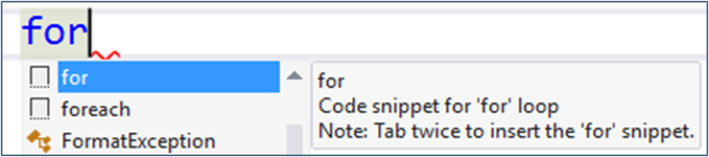
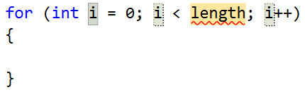
Example: Divisible by 3
Print the numbers from 1 to 100 that are divisible by 3
You can use "for" code snippet in Visual Studio
for (var i = 3; i <= 100; i += 3)
{
Console.WriteLine(i);
}
Push [Tab] twice
Check your solution here: https://judge.softuni.org/Contests/Practice/Index/1188#7

Slide 41
Problem: Sum of Odd Numbers
Write a program to print the first n odd numbers and their sum
1
3
5
7
9
Sum: 25
1
3
5
Sum: 9
5
3
Check your solution here: https://judge.softuni.org/Contests/Practice/Index/1188#8

Slide 42
Solution: Sum of Odd Numbers
var n = int.Parse(Console.ReadLine());
var sum = 0;
for (int i = 1; i <= n; i++)
{
Console.WriteLine("{0}", 2 * i - 1);
sum += 2 * i - 1;
}
Console.WriteLine("Sum:{0}", sum);
Check your solution here: https://judge.softuni.org/Contests/Practice/Index/1188#8

Slide 43

Iterations While a Condition is True
While Loops

Slide 44
While Loops
Executes commands while the condition is true:
Initial value
var n = 1;
while (n <= 10)
{
Console.WriteLine(n);
n++;
}
Condition
Loop body
Increment the counter

Slide 45
Problem: Multiplication Table
Print a table holding number*1, number*2, …, number*10
var number = int.Parse(Console.ReadLine());
var times = 1;
while (times <= 10)
{
Console.WriteLine(
$"{number} X {times} = {number * times}");
times++;
}
Check your solution here: https://judge.softuni.org/Contests/Practice/Index/1188#9

Slide 46

Do…While Loop
Executes Code Block One or More Times

Slide 47
Do...While Loop
Similar to the while loop, but always executes at least once:
Initial value
int i = 1;
do
{
Console.WriteLine(i);
i++;
}
while (i <= 10);
Increment the counter
Loop body
Condition

Slide 48
Problem: Multiplication Table 2.0
Upgrade your program and take the initial times from the console
int number = int.Parse(Console.ReadLine());
int times = int.Parse(Console.ReadLine());
do
{
Console.WriteLine(
$"{number} X {times} = {number * times}"
);
times++;
} while (times <= 10);
Check your solution here: https://judge.softuni.org/Contests/Practice/Index/1188#10

Slide 49

Debugging and Troubleshooting
Using the Visual Studio Debugger

Slide 50

Debugging the Code
The process of debugging application includes:
Spotting an error
Finding the lines of code that cause the error
Fixing the error in the code
Testing to check if the error is gone and no new errors are introduced
Iterative and continuous process

Slide 51
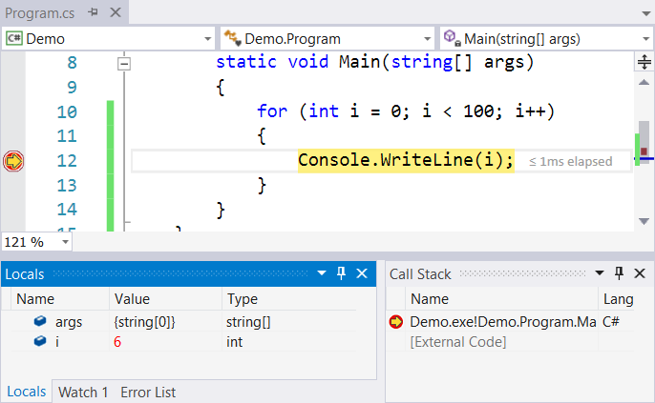
Debugging in Visual Studio
Visual Studio has a built-in debugger
It provides:
Breakpoints
Ability to trace the code execution
Ability to inspect variables at runtime

Slide 52
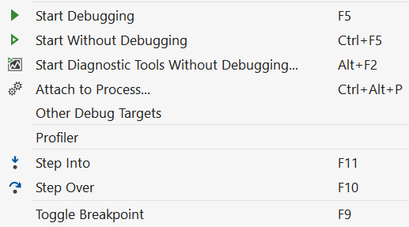
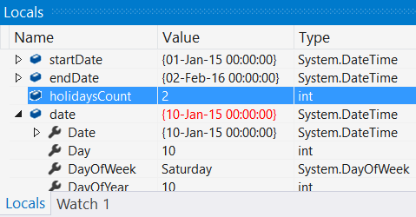
Using the Debugger in Visual Studio
Start without Debugger: [Ctrl+F5]
Toggle a breakpoint: [F9]
Start with the Debugger: [F5]
Trace the program: [F10] / [F11]
Using the Locals / Watches
Conditional breakpoints
Enter debug mode after exception

Slide 53
Problem: Find and Fix the Bugs in the Code
A program aims to count the non-working days between two dates (e.g. 1.05.2016 … 15.05.2016 → 5 non-working days). Debug it!
var startDate = DateTime.ParseExact(Console.ReadLine(),
"dd.m.yyyy", CultureInfo.InvariantCulture);
var endDate = DateTime.ParseExact(Console.ReadLine(),
"dd.m.yyyy", CultureInfo.InvariantCulture);
var holidaysCount = 0;
for (var date = startDate; date <= endDate; date.AddDays(1))
if (date.DayOfWeek == DayOfWeek.Saturday &&
date.DayOfWeek == DayOfWeek.Sunday) holidaysCount++;
Console.WriteLine(holidaysCount);
Check your solution here: https://judge.softuni.org/Contests/Practice/Index/1188#12

Slide 54

Summary
Declaring Variables
Using Console – Reading and Writing
Conditional Statements allow implementing programming logic
Loops repeat code block multiple times
Using the debugger
…
…
…

Slide 55
Questions?
Notes:
55

Slide 56












SoftUni Diamond Partners

Slide 57


Educational Partners

Slide 58
Trainings @ Software University (SoftUni)
Software University – High-Quality Education, Profession and Job for Software Developers
softuni.bg, about.softuni.bg
Software University Foundation
softuni.foundation
Software University @ Facebook
facebook.com/SoftwareUniversity
Software University Forums
forum.softuni.bg
Notes:
58

Slide 59

License
This course (slides, examples, demos, exercises, homework, documents, videos and other assets) is copyrighted content
Unauthorized copy, reproduction or use is illegal
© SoftUni – https://about.softuni.bg/
© Software University – https://softuni.bg
Notes:
59

